Slide 1
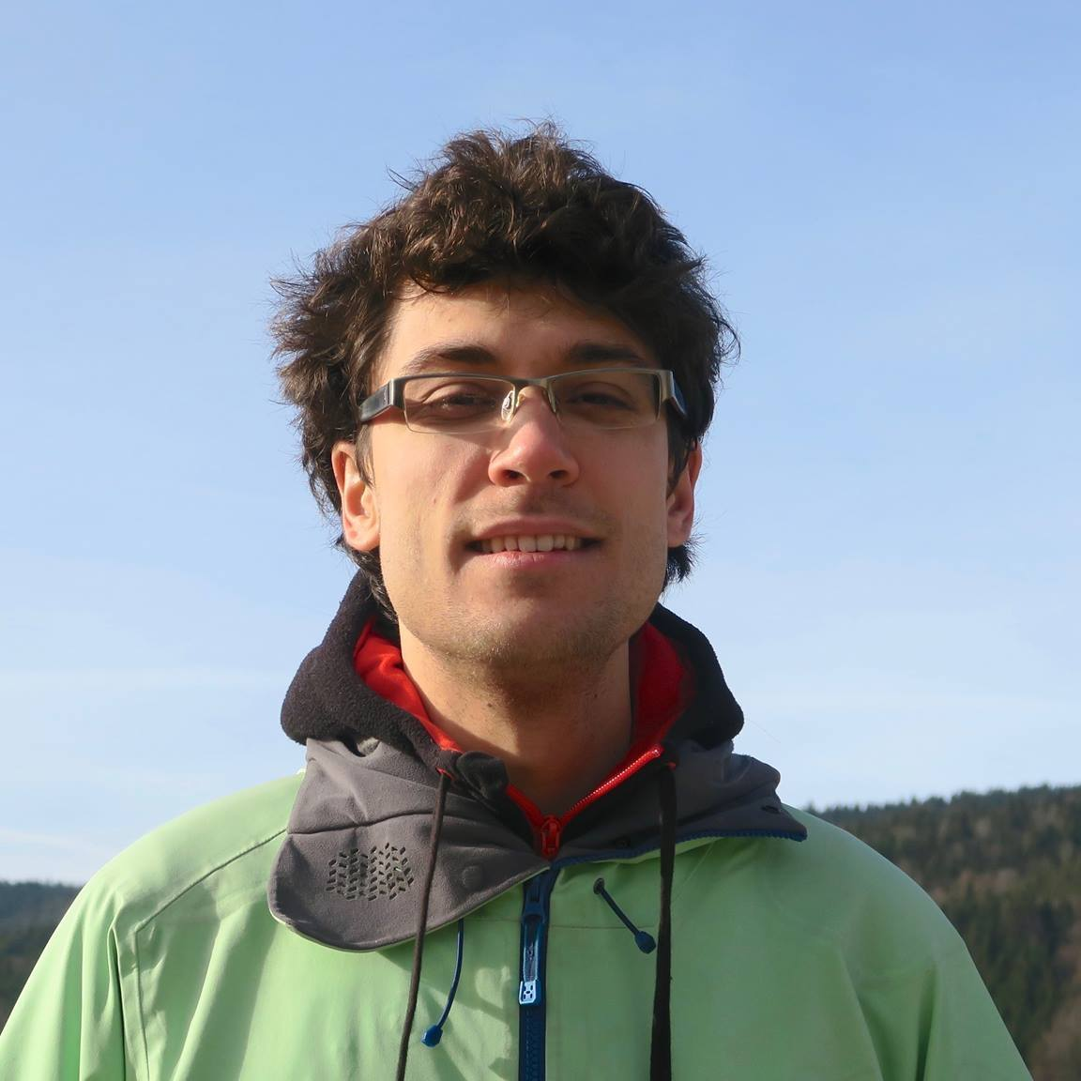

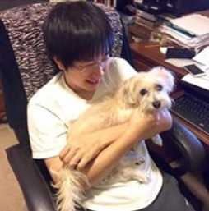
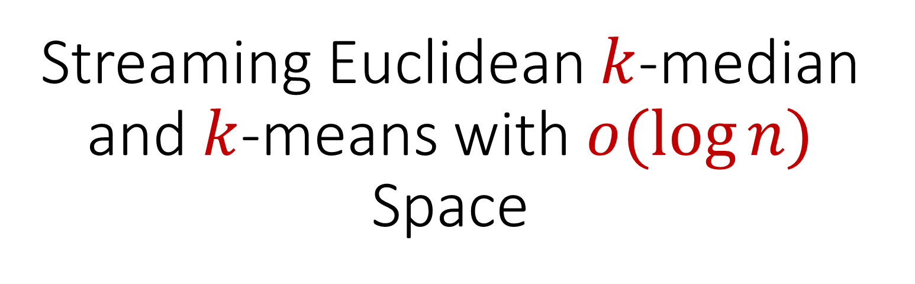
Streaming Euclidean $k$-median and $k$-means with $o(\log{n)}$ Space
Vincent Cohen-Addad
David P. Woodruff
Samson Zhou

Slide 2

Goal: Cluster a stream of $n$ points using $o(\log{n)}$ space

Slide 3
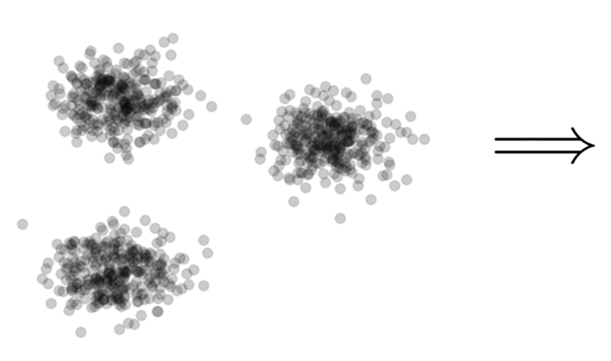

Clustering
Goal: Given input dataset $X$, partition $X$ so that “similar” points are in the same cluster and “different” points are in different clusters

Slide 4
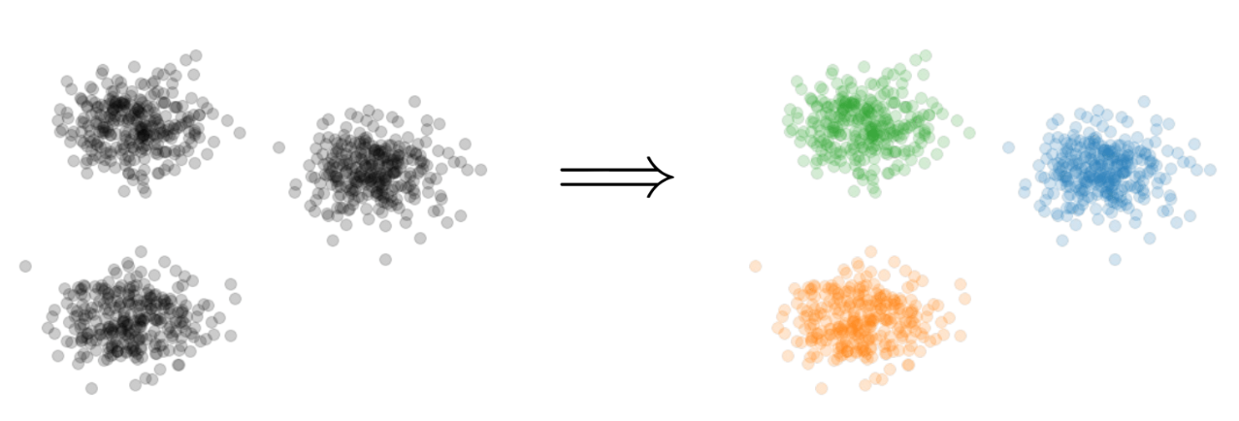


$k$-Clustering
Goal: Given input dataset $X$, partition $X$ so that “similar” points are in the same cluster and “different” points are in different clusters
There can be at most $k$ different clusters
$$k=3$$

Slide 5
$k$-Clustering
Question: How do we measure the “quality” of each clustering?
$$k=3$$

Slide 6
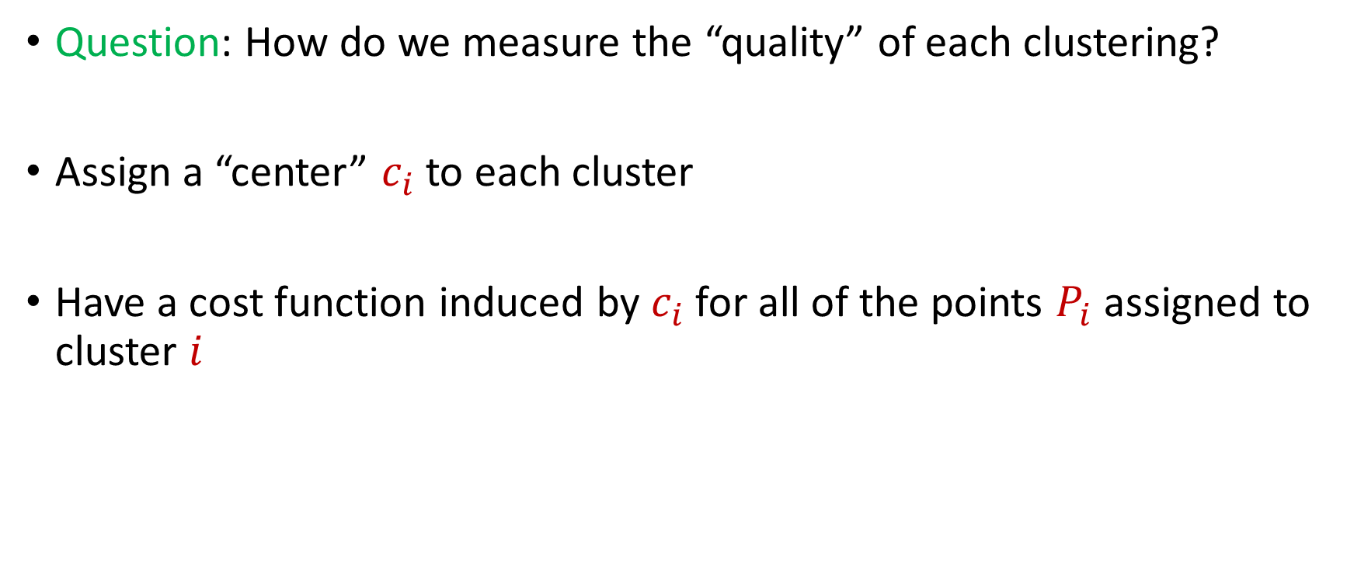
$k$-Clustering
Question: How do we measure the “quality” of each clustering?
Assign a “center” $c_{i}$ to each cluster
Have a cost function induced by $c_{i}$ for all of the points $P_{i}$ assigned to cluster $i$

Slide 7
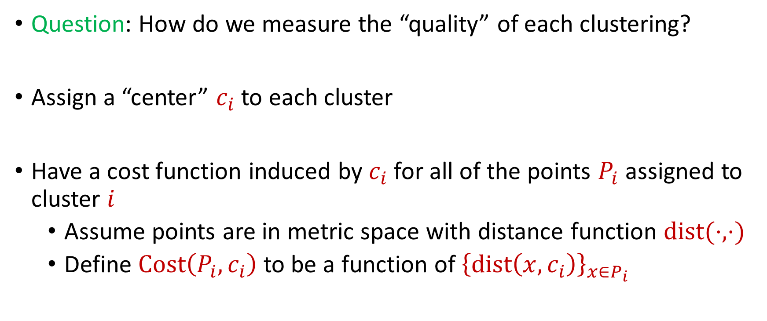
$k$-Clustering
Question: How do we measure the “quality” of each clustering?
Assign a “center” $c_{i}$ to each cluster
Have a cost function induced by $c_{i}$ for all of the points $P_{i}$ assigned to cluster $i$
Assume points are in metric space with distance function $dist(⋅,⋅)$
Define $Cost\left(P_{i},c_{i}\right)$ to be a function of ${\left\{dist\left(x,c_{i}\right)\right\}}_{x∈P_{i}}$

Slide 8
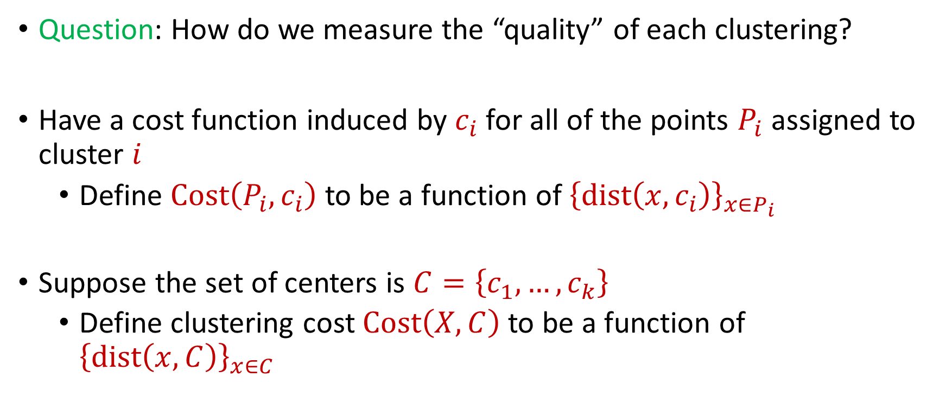
$k$-Clustering
Question: How do we measure the “quality” of each clustering?
Have a cost function induced by $c_{i}$ for all of the points $P_{i}$ assigned to cluster $i$
Define $Cost\left(P_{i},c_{i}\right)$ to be a function of ${\left\{dist\left(x,c_{i}\right)\right\}}_{x∈P_{i}}$
Suppose the set of centers is $C=\left\{c_{1},…, c_{k}\right\}$
Define clustering cost $Cost\left(X,C\right)$ to be a function of ${\left\{dist\left(x,C\right)\right\}}_{x∈C}$

Slide 9

$k$-Clustering
Define clustering cost $Cost\left(X,C\right)$ to be a function of ${\left\{dist\left(x,C\right)\right\}}_{x∈C}$

Slide 10
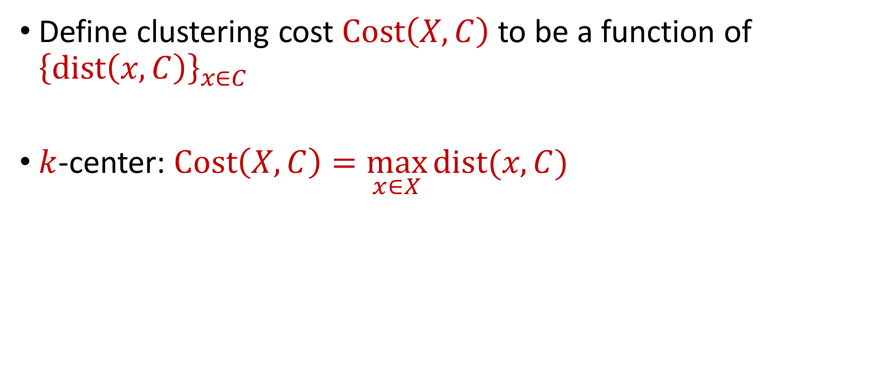
$k$-Clustering
Define clustering cost $Cost\left(X,C\right)$ to be a function of ${\left\{dist\left(x,C\right)\right\}}_{x∈C}$
$k$-center: $Cost\left(X,C\right)=\max_{x∈X}{dist(x,C)}$

Slide 11
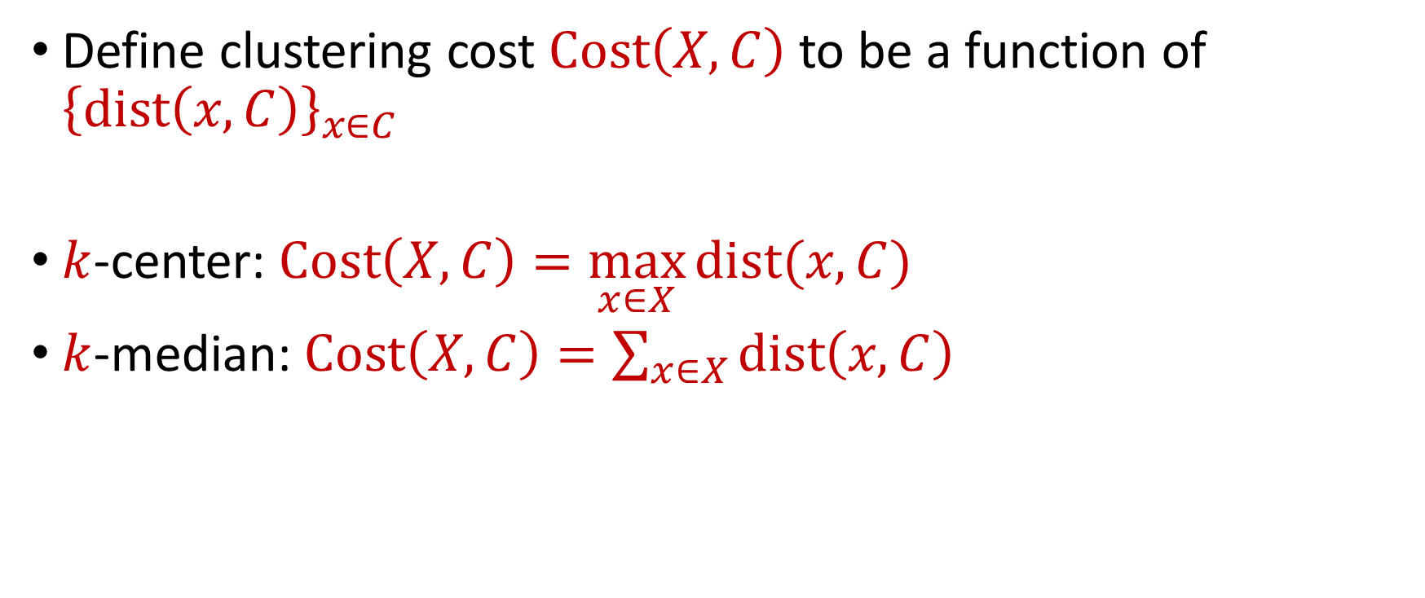
$k$-Clustering
Define clustering cost $Cost\left(X,C\right)$ to be a function of ${\left\{dist\left(x,C\right)\right\}}_{x∈C}$
$k$-center: $Cost\left(X,C\right)=\max_{x∈X}{dist(x,C)}$
$k$-median: $Cost\left(X,C\right)=\sum_{x∈X}{dist\left(x,C\right)}$

Slide 12

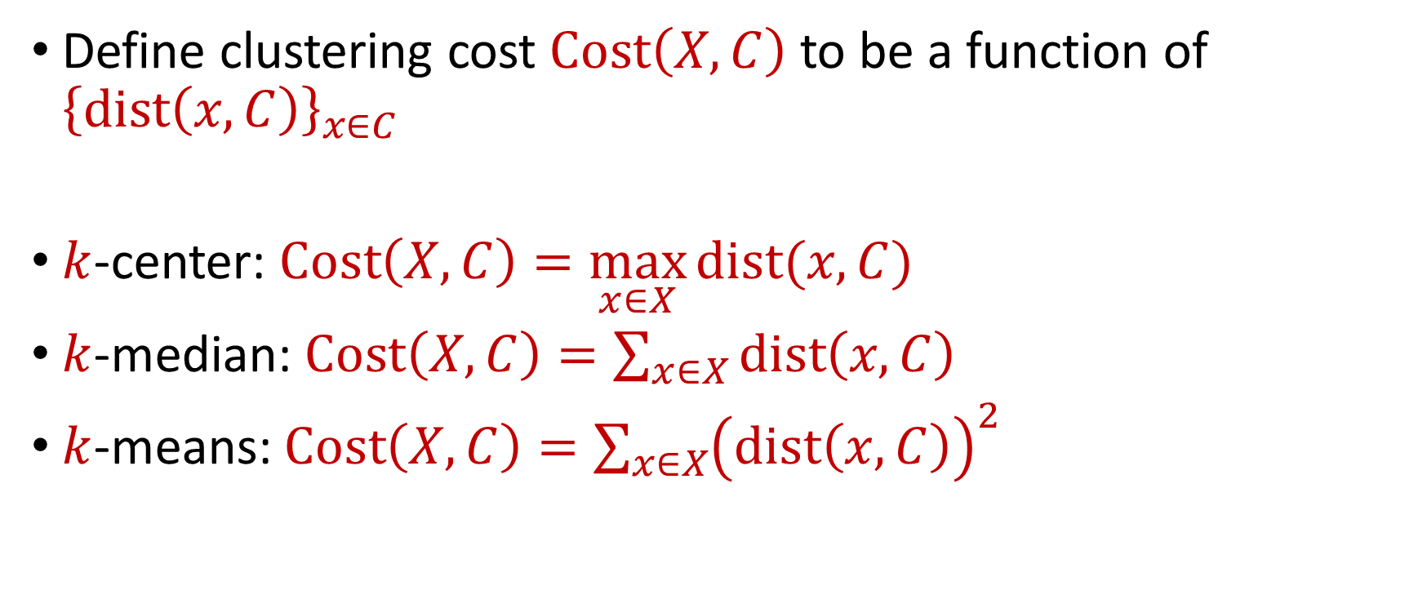






$k$-Clustering
Define clustering cost $Cost\left(X,C\right)$ to be a function of ${\left\{dist\left(x,C\right)\right\}}_{x∈C}$
$k$-center: $Cost\left(X,C\right)=\max_{x∈X}{dist(x,C)}$
$k$-median: $Cost\left(X,C\right)=\sum_{x∈X}{dist\left(x,C\right)}$
$k$-means: $Cost\left(X,C\right)=\sum_{x∈X}{{\left(dist\left(x,C\right)\right)}^{2}}$
$${\left(⋅\right)}^{2}$$
$${\left(⋅\right)}^{2}$$
$${\left(⋅\right)}^{2}$$
$${\left(⋅\right)}^{2}$$
$${\left(⋅\right)}^{2}$$
$${\left(⋅\right)}^{2}$$
$${\left(⋅\right)}^{2}$$

Slide 13

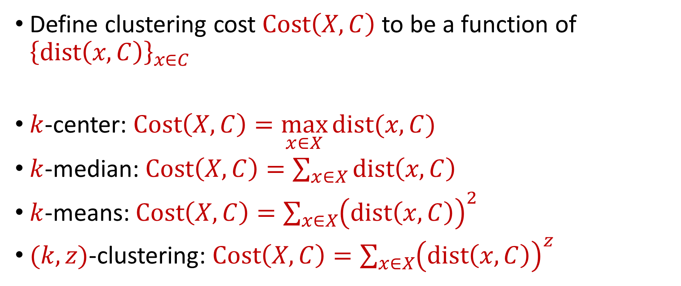






$k$-Clustering
Define clustering cost $Cost\left(X,C\right)$ to be a function of ${\left\{dist\left(x,C\right)\right\}}_{x∈C}$
$k$-center: $Cost\left(X,C\right)=\max_{x∈X}{dist(x,C)}$
$k$-median: $Cost\left(X,C\right)=\sum_{x∈X}{dist\left(x,C\right)}$
$k$-means: $Cost\left(X,C\right)=\sum_{x∈X}{{\left(dist\left(x,C\right)\right)}^{2}}$
$(k,z)$-clustering: $Cost\left(X,C\right)=\sum_{x∈X}{{\left(dist\left(x,C\right)\right)}^{z}}$
$${\left(⋅\right)}^{z}$$
$${\left(⋅\right)}^{z}$$
$${\left(⋅\right)}^{z}$$
$${\left(⋅\right)}^{z}$$
$${\left(⋅\right)}^{z}$$
$${\left(⋅\right)}^{z}$$
$${\left(⋅\right)}^{z}$$

Slide 14
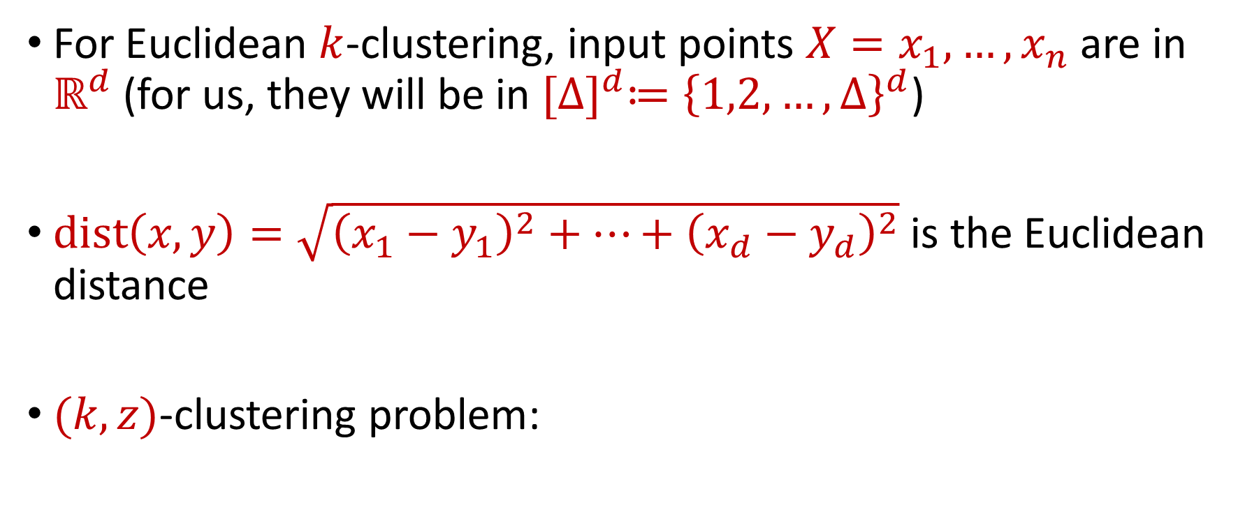


Euclidean $k$-Clustering
For Euclidean $k$-clustering, input points $X=x_{1},…,x_{n}$ are in $ℝ^{d}$ (for us, they will be in ${[Δ]}^{d}≔{\left\{1,2,…,Δ\right\}}^{d}$)
$dist\left(x,y\right)=\sqrt{{\left(x_{1}−y_{1}\right)}^{2}+…+{\left(x_{d}−y_{d}\right)}^{2}}$ is the Euclidean distance
$(k,z)$-clustering problem:
$$\min_{C:\left|C\right|≤k} Cost\left(X,C\right)=\min_{C:\left|C\right|≤k}{Σ_{x∈X}\left(dist\left(x,C\right)\right)}^{z}$$

Slide 15

The Streaming Model
Input: Updates to an underlying data set $X$ that arrive sequentially
Output: Evaluation (or approximation) of a given function
Goal: Use space sublinear in the size $n$of the input $X$

Slide 16
Goal: Cluster a stream of $n$ points using $o(\log{n)}$ space

Slide 17
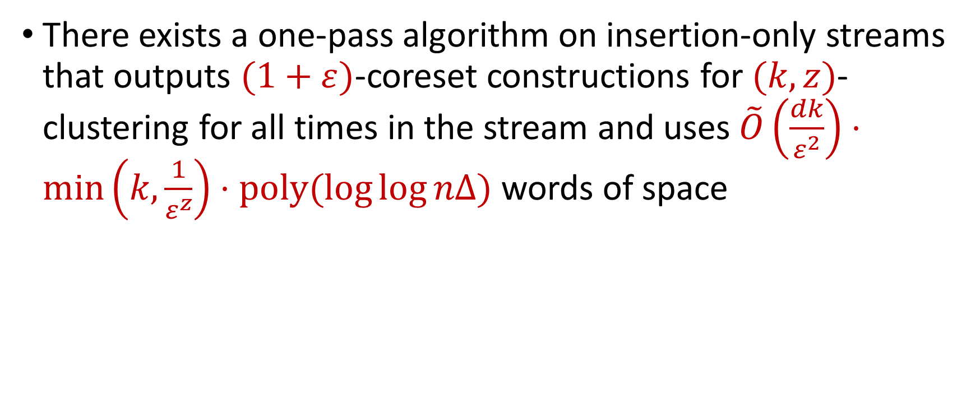
Our Results (Insertion-Only)
There exists a one-pass algorithm on insertion-only streams that outputs $(1+ε)$-coreset constructions for $(k,z)$-clustering for all times in the stream and uses $\tilde{O}\left(\frac{dk}{ε^{2}}\right)⋅\min\left(k,\frac{1}{ε^{z}}\right)⋅poly(\log{\log{nΔ)}}$ words of space

Slide 18
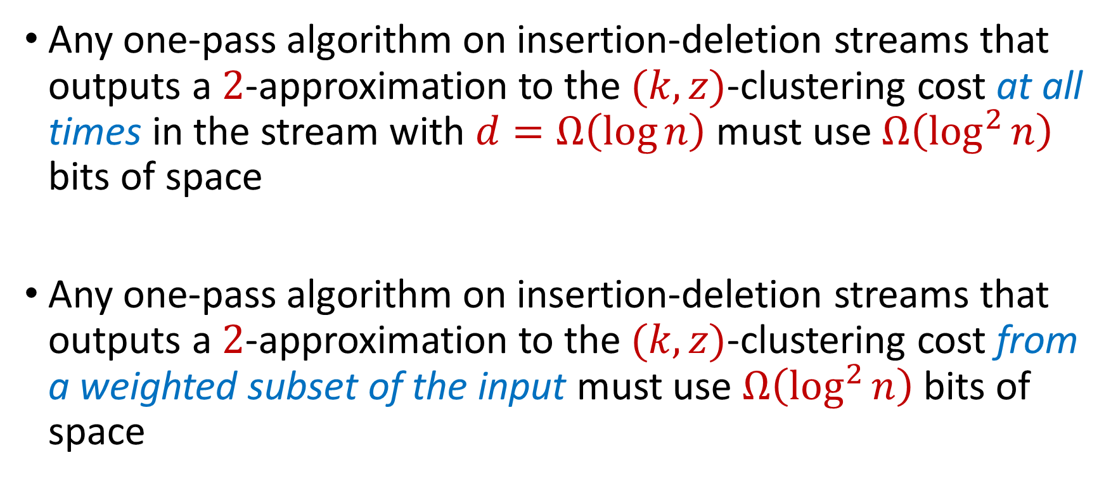
Our Results (Insertion-Deletion Impossibility)
Any one-pass algorithm on insertion-deletion streams that outputs a $2$-approximation to the $(k,z)$-clustering cost at all times in the stream with $d=Ω\left(\log{n}\right)$ must use $Ω\left(\log^{2}{n}\right)$ bits of space
Any one-pass algorithm on insertion-deletion streams that outputs a $2$-approximation to the $(k,z)$-clustering cost from a weighted subset of the input must use $Ω\left(\log^{2}{n}\right)$ bits of space

Slide 19
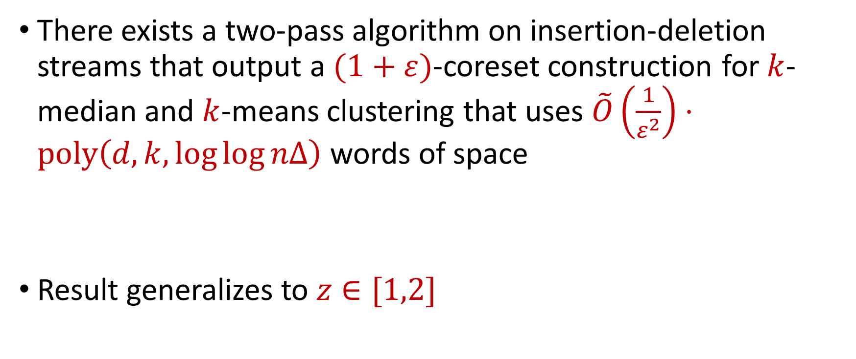
Our Results (Insertion-Deletion Two-Pass)
There exists a two-pass algorithm on insertion-deletion streams that output a $(1+ε)$-coreset construction for $k$-median and $k$-means clustering that uses $\tilde{O}\left(\frac{1}{ε^{2}}\right)⋅poly\left(d,k,\log{\log{nΔ}}\right)$ words of space
Result generalizes to $z∈[1,2]$

Slide 20

Our Results (Sum of the Online Sensitivities)
Sum of the online sensitivities of a set of $n$ points in $ℝ^{d}$ for $(k,z)$-clustering is at most $O\left(k\log^{2}{(ndΔ)}\right)$

Slide 21
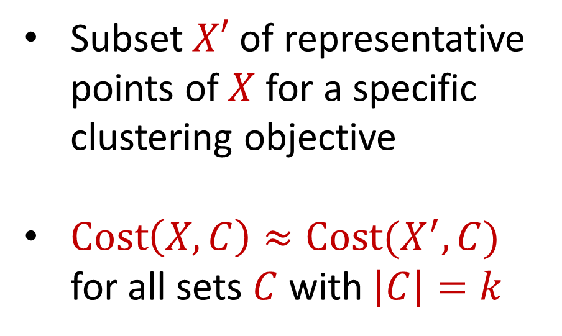
Coreset
Subset $X′$ of representative points of $X$ for a specific clustering objective
$Cost\left(X,C\right)≈Cost(X^{′},C)$ for all sets $C$ with $\left|C\right|=k$

Slide 22
Coreset
Subset $X′$ of representative points of $X$ for a specific clustering objective
$Cost\left(X,C\right)≈Cost(X^{′},C)$ for all sets $C$ with $\left|C\right|=k$

Slide 23
Coreset
Subset $X′$ of representative points of $X$ for a specific clustering objective
$Cost\left(X,C\right)≈Cost(X^{′},C)$ for all sets $C$ with $\left|C\right|=k$

Slide 24

Coreset (Formal Definition)
Given a set $X$ and an accuracy parameter $ε>0$, we say a set $X′$ with weight function $w$is an $(1+ε)$-multiplicative coreset for a cost function $Cost$, if for all queries $C$ with $\left|C\right|≤k$, we have
$$\left(1−ε\right)Cost(X,C)≤Cost(X′,C,w)≤\left(1+ε\right)Cost(X,C)$$
$(k,z)$-clustering: $Cost\left(X^{′},C,w\right)=\sum_{x∈X′}{{w\left(x\right)⋅\left(dist\left(x,C\right)\right)}^{z}}$

Slide 25
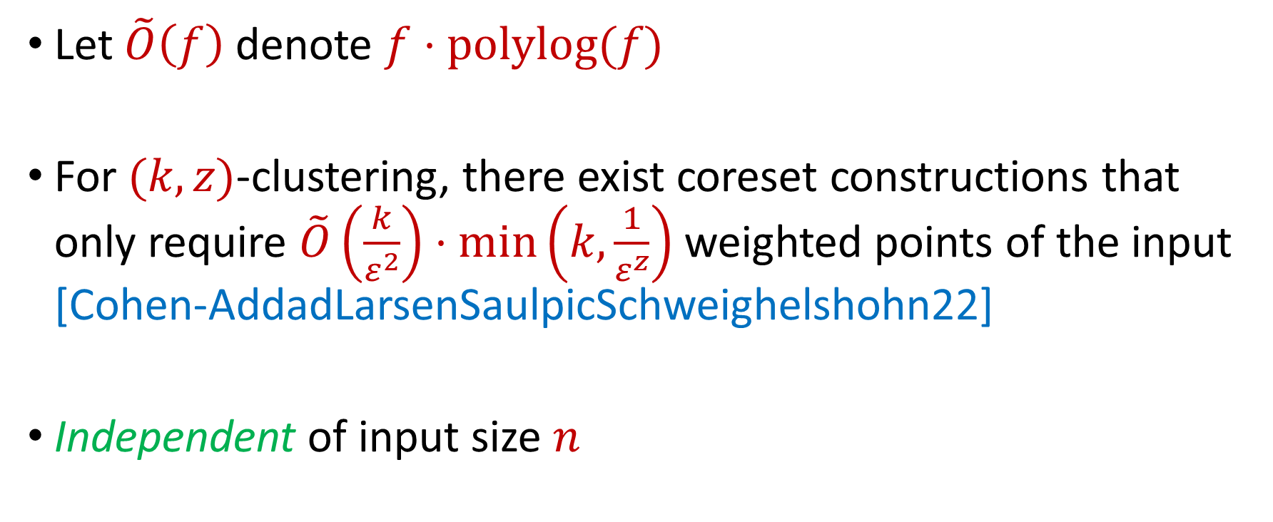
Coreset Constructions
Let $\tilde{O}\left(f\right)$ denote $f⋅polylog(f)$
For $(k,z)$-clustering, there exist coreset constructions that only require $\tilde{O}\left(\frac{k}{ε^{2}}\right)⋅\min\left(k,\frac{1}{ε^{z}}\right)$ weighted points of the input [Cohen-AddadLarsenSaulpicSchweighelshohn22]
Independent of input size $n$

Slide 26
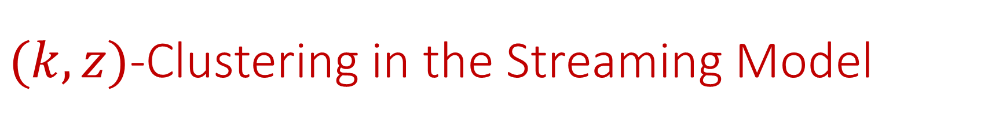
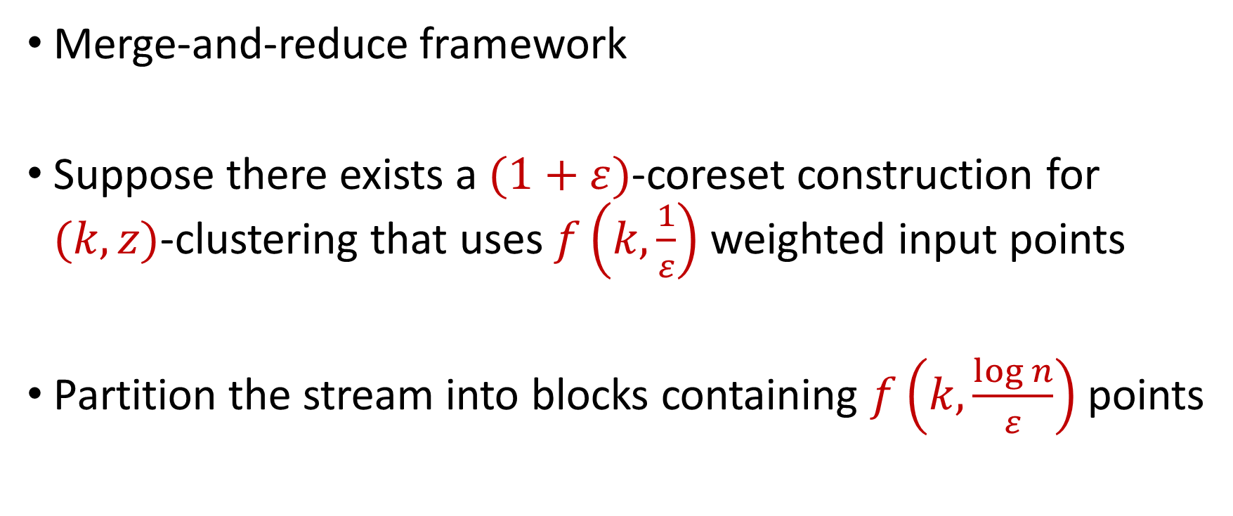
$(k,z)$-Clustering in the Streaming Model
Merge-and-reduce framework
Suppose there exists a $(1+ε)$-coreset construction for $(k,z)$-clustering that uses $f\left(k,\frac{1}{ε}\right)$ weighted input points
Partition the stream into blocks containing $f\left(k,\frac{\log{n}}{ε}\right)$ points

Slide 27
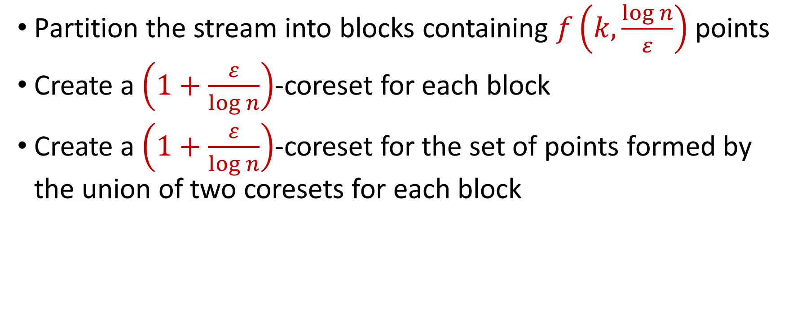
$(k,z)$-Clustering in the Streaming Model
Partition the stream into blocks containing $f\left(k,\frac{\log{n}}{ε}\right)$ points
Create a $\left(1+\frac{ε}{\log{n}}\right)$-coreset for each block
Create a $\left(1+\frac{ε}{\log{n}}\right)$-coreset for the set of points formed by the union of two coresets for each block
Reduce
Merge

Slide 28
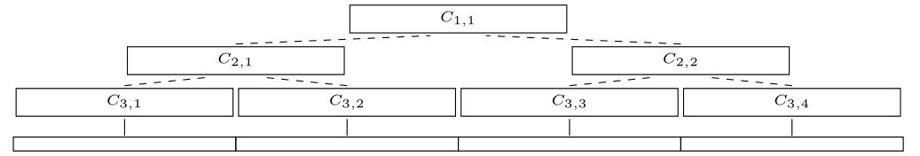
$(k,z)$-Clustering in the Streaming Model
Partition the stream into blocks containing $f\left(k,\frac{\log{n}}{ε}\right)$ points
Create a $\left(1+\frac{ε}{\log{n}}\right)$-coreset for each block
Create a $\left(1+\frac{ε}{\log{n}}\right)$-coreset for the set of points formed by the union of two coresets for each block

Slide 29
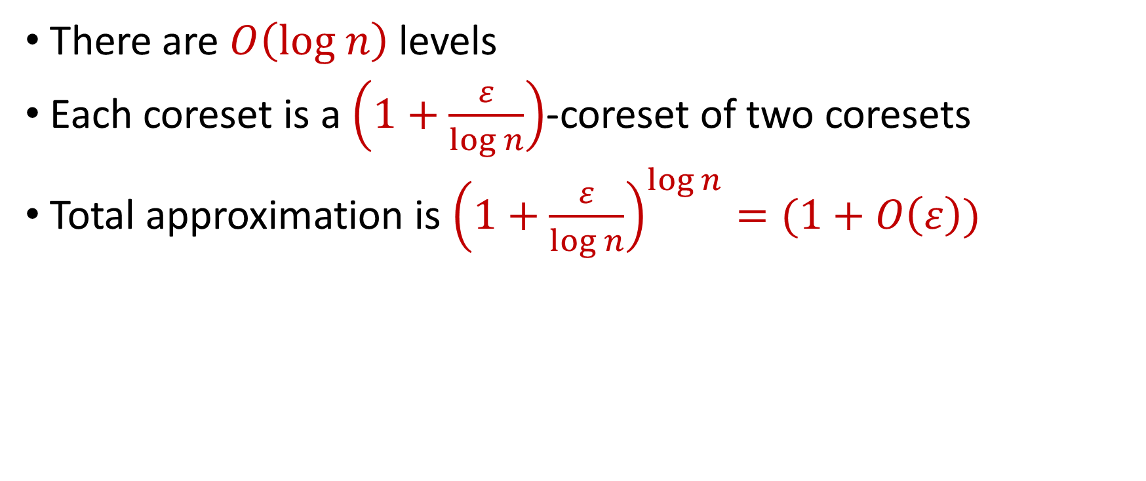
$(k,z)$-Clustering in the Streaming Model
There are $O\left(log n\right)$ levels
Each coreset is a $\left(1+\frac{ε}{\log{n}}\right)$-coreset of two coresets
Total approximation is ${\left(1+\frac{ε}{\log{n}}\right)}^{\log{n}}=(1+O\left(ε\right))$

Slide 30
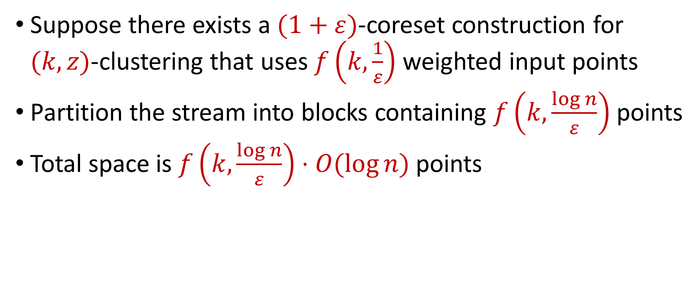
$(k,z)$-Clustering in the Streaming Model
Suppose there exists a $(1+ε)$-coreset construction for $(k,z)$-clustering that uses $f\left(k,\frac{1}{ε}\right)$ weighted input points
Partition the stream into blocks containing $f\left(k,\frac{\log{n}}{ε}\right)$ points
Total space is $f\left(k,\frac{\log{n}}{ε}\right)⋅O(log{n)}$ points
For $k$-means clustering, this is $\tilde{O}\left(\frac{k}{ε^{2}}⋅\log^{3}{n}\right)$ points

Slide 31
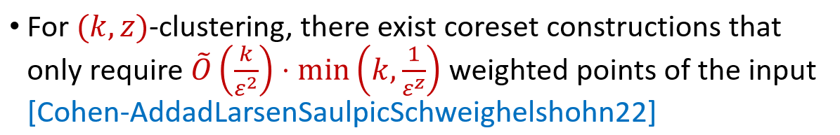
$(k,z)$-Clustering in the Streaming Model
Suppose there exists a $(1+ε)$-coreset construction for $(k,z)$-clustering that uses $f\left(k,\frac{1}{ε}\right)$ weighted input points
Partition the stream into blocks containing $f\left(k,\frac{\log{n}}{ε}\right)$ points
Total space is $f\left(k,\frac{\log{n}}{ε}\right)⋅O(log{n)}$ points

Slide 32
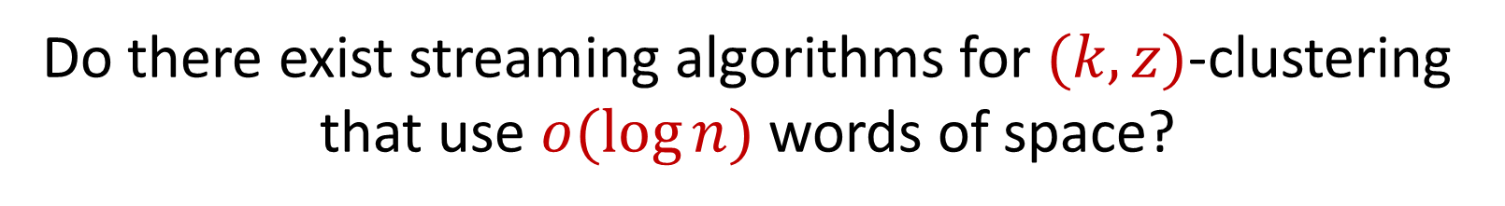

$(k,z)$-Clustering in the Streaming Model
Suppose there exists a $(1+ε)$-coreset construction for $(k,z)$-clustering that uses $f\left(k,\frac{1}{ε}\right)$ weighted input points
Partition the stream into blocks containing $f\left(k,\frac{\log{n}}{ε}\right)$ points
Total space is $f\left(k,\frac{\log{n}}{ε}\right)⋅O(log{n)}$ points
Do there exist streaming algorithms for $(k,z)$-clustering that use $o(\log{n)}$ words of space?

Slide 33
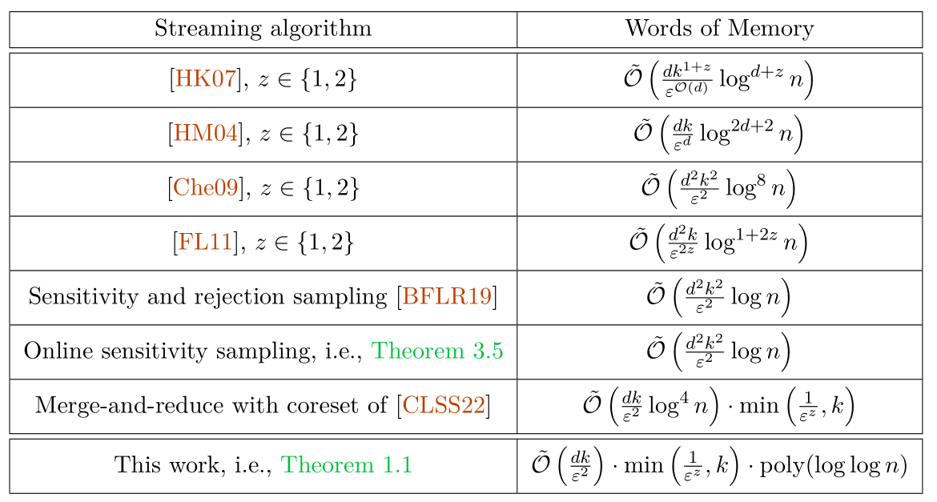

Slide 34

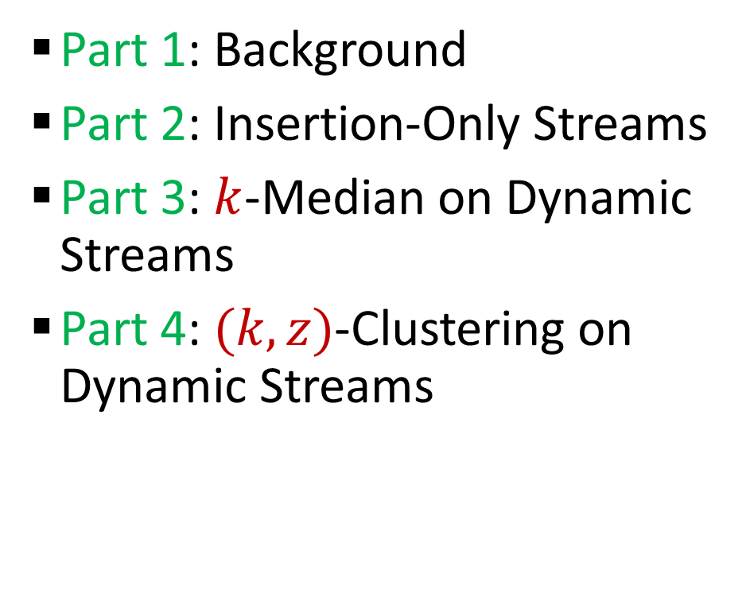
Questions?
Format
Part 1: Background
Part 2: Insertion-Only Streams
Part 3: $k$-Median on Dynamic Streams
Part 4: $(k,z)$-Clustering on Dynamic Streams

Slide 35

Coreset Construction and Sampling
Consider a fixed set $X$ and a fixed set $C$ of $k$ centers, which induces a fixed cost $Cost(X,C)$

Slide 36

Coreset Construction and Sampling
Consider a fixed set $X$ and a fixed set $C$ of $k$ centers, which induces a fixed cost $Cost(X,C)$
A simple way to obtain $X′$with $Cost\left(X^{′},C\right)≈Cost(X,C)$ is to uniformly sample points of $X$ into $X′$

Slide 37

Coreset Construction and Sampling
Consider a fixed set $X$ and a fixed set $C$ of $k$ centers, which induces a fixed cost $Cost(X,C)$
Uniform sampling needs a lot of samples of there is a single point that greatly contributes to $Cost(X,C)$

Slide 38

Coreset Construction and Sampling
Fix: Importance sampling, sample each point $x∈X$ into $X′$ with probability proportional $Cost(x,C)$, i.e., $Cost(x,C)/Cost(X,C)$

Slide 39
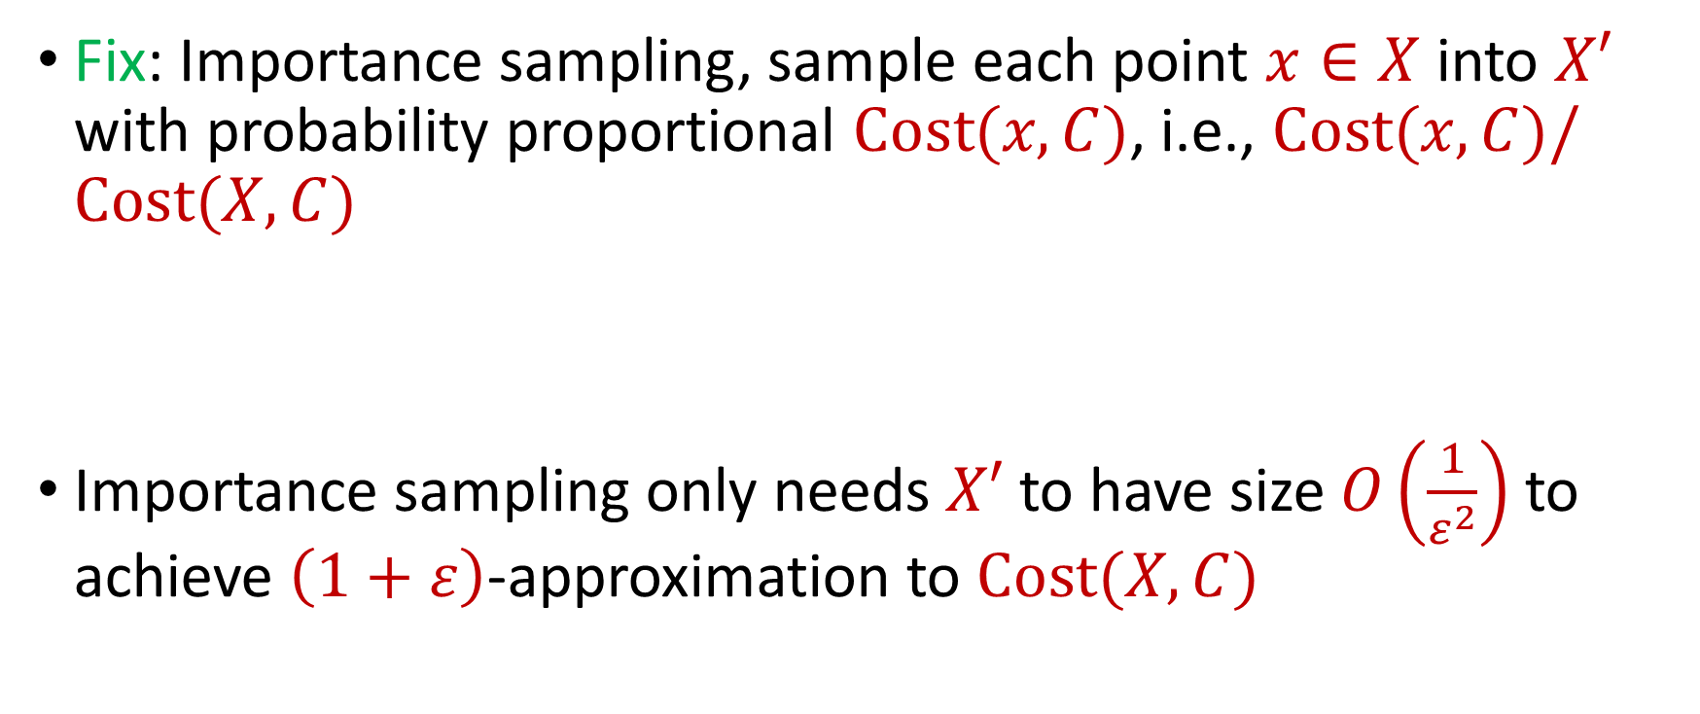
Coreset Construction and Sampling
Fix: Importance sampling, sample each point $x∈X$ into $X′$ with probability proportional $Cost(x,C)$, i.e., $Cost(x,C)/Cost(X,C)$
Importance sampling only needs $X′$ to have size $O\left(\frac{1}{ε^{2}}\right)$ to achieve $\left(1+ε\right)$-approximation to $Cost(X,C)$

Slide 40

Coreset Construction and Sampling
Importance sampling only needs $X′$ to have size $O\left(\frac{1}{ε^{2}}\right)$ to achieve $\left(1+ε\right)$-approximation to $Cost(X,C)$
To handle all possible sets of $k$ centers:

Slide 41
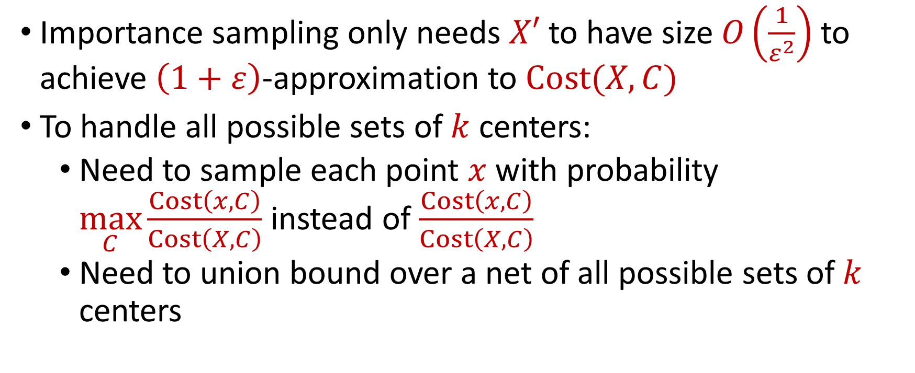
Coreset Construction and Sampling
Importance sampling only needs $X′$ to have size $O\left(\frac{1}{ε^{2}}\right)$ to achieve $\left(1+ε\right)$-approximation to $Cost(X,C)$
To handle all possible sets of $k$ centers:
Need to sample each point $x$ with probability $\max_{C}\frac{Cost\left(x,C\right)}{Cost\left(X,C\right)}$ instead of $\frac{Cost\left(x,C\right)}{Cost\left(X,C\right)}$
Need to union bound over a net of all possible sets of $k$ centers

Slide 42

Coreset Construction and Sampling
Importance sampling only needs $X′$ to have size $O\left(\frac{1}{ε^{2}}\right)$ to achieve $\left(1+ε\right)$-approximation to $Cost(X,C)$
To handle all possible sets of $k$ centers:
Need to sample each point $x$ with probability $\max_{C}\frac{Cost\left(x,C\right)}{Cost\left(X,C\right)}$ instead of $\frac{Cost\left(x,C\right)}{Cost\left(X,C\right)}$
Need to union bound over a net of all possible sets of $k$ centers
Net with size ${\left(\frac{nΔ}{ε}\right)}^{O(kd)}$

Slide 43
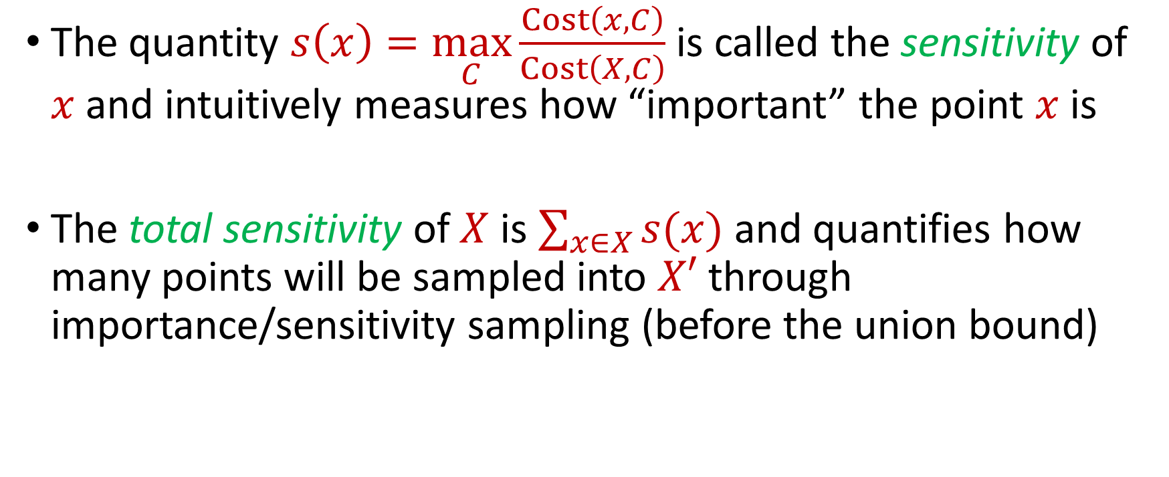
Sensitivity Sampling
The quantity $s\left(x\right)=\max_{C}\frac{Cost\left(x,C\right)}{Cost\left(X,C\right)}$ is called the sensitivity of $x$ and intuitively measures how “important” the point $x$ is
The total sensitivity of $X$ is $\sum_{x∈X}{s(x)}$ and quantifies how many points will be sampled into $X′$ through importance/sensitivity sampling (before the union bound)

Slide 44
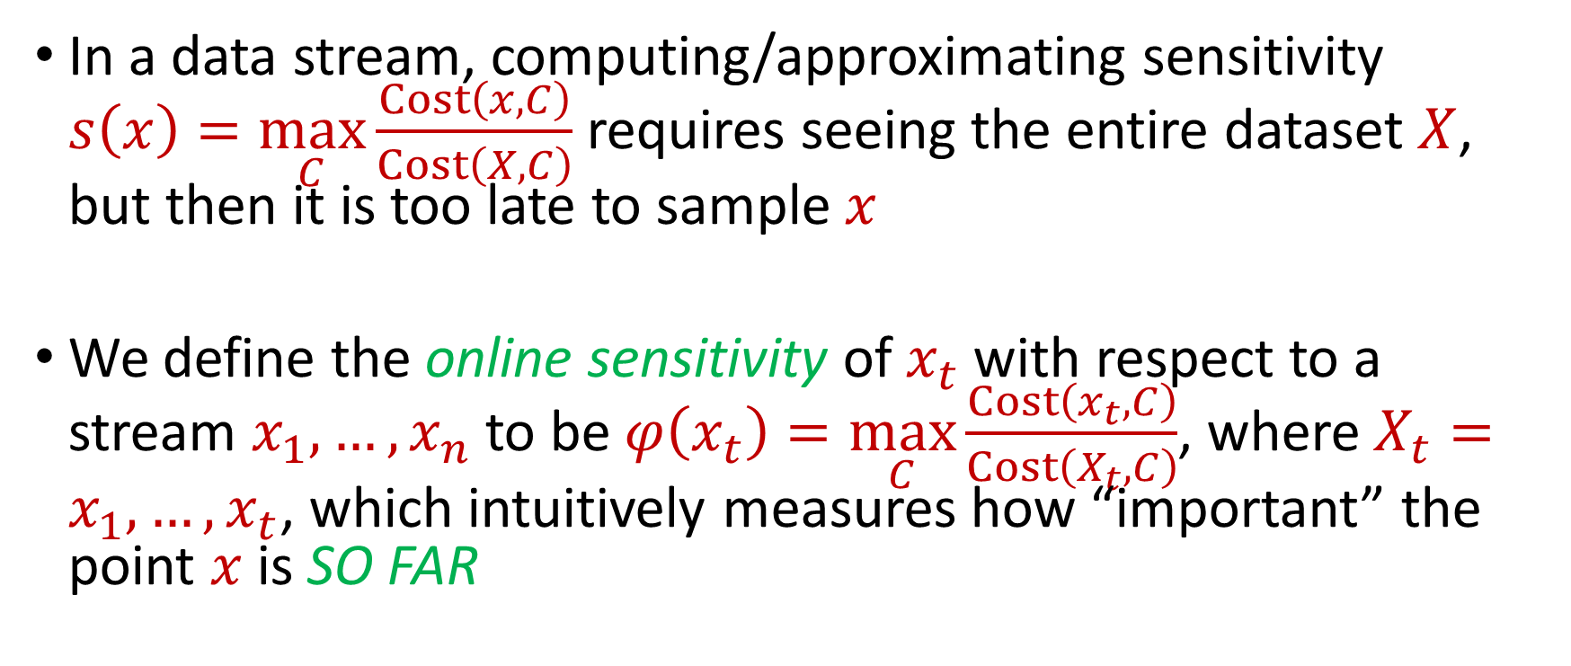
Online Sensitivity
In a data stream, computing/approximating sensitivity $s\left(x\right)=\max_{C}\frac{Cost\left(x,C\right)}{Cost\left(X,C\right)}$ requires seeing the entire dataset $X$, but then it is too late to sample $x$
We define the online sensitivity of $x_{t}$ with respect to a stream $x_{1},…,x_{n}$ to be $φ\left(x_{t}\right)=\max_{C}\frac{Cost\left(x_{t},C\right)}{Cost\left(X_{t},C\right)}$, where $X_{t}=x_{1},…,x_{t}$, which intuitively measures how “important” the point $x$ is SO FAR

Slide 45
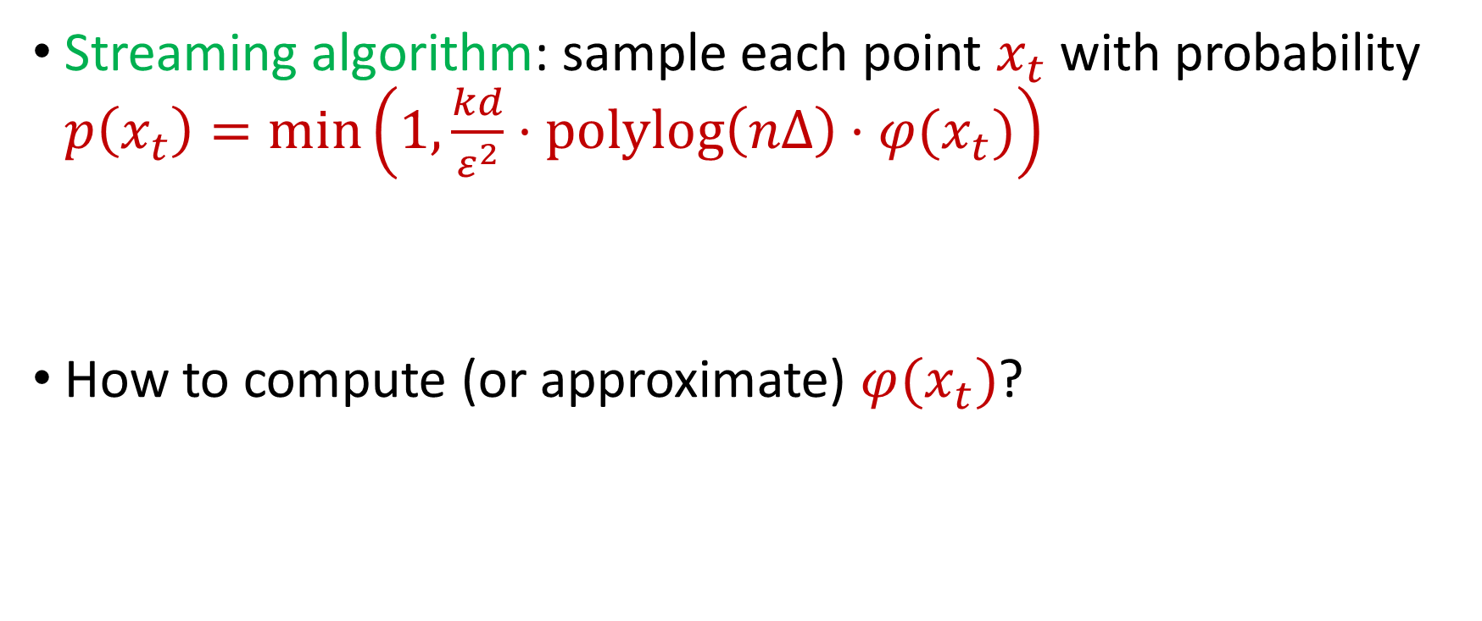
Online Sensitivity
Streaming algorithm: sample each point $x_{t}$ with probability $p\left(x_{t}\right)=\min\left(1,\frac{kd}{ε^{2}}⋅polylog\left(nΔ\right)⋅φ(x_{t})\right)$
How to compute (or approximate) $φ(x_{t})$?

Slide 46
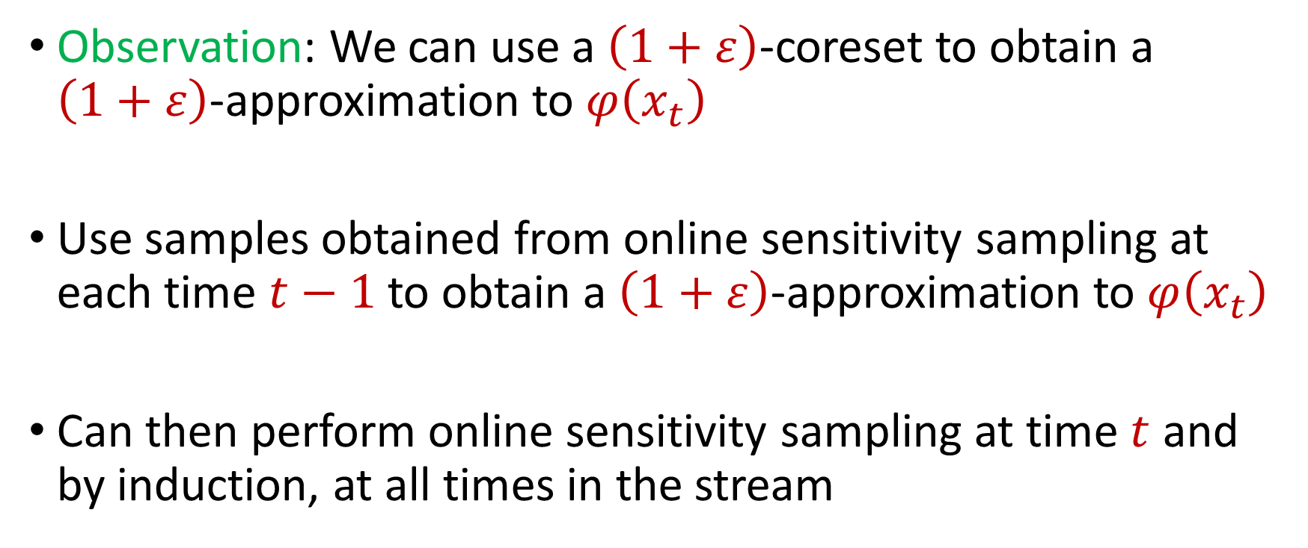
Online Sensitivity
Observation: We can use a $\left(1+ε\right)$-coreset to obtain a $\left(1+ε\right)$-approximation to $φ\left(x_{t}\right)$
Use samples obtained from online sensitivity sampling at each time $t−1$ to obtain a $\left(1+ε\right)$-approximation to $φ\left(x_{t}\right)$
Can then perform online sensitivity sampling at time $t$ and by induction, at all times in the stream

Slide 47
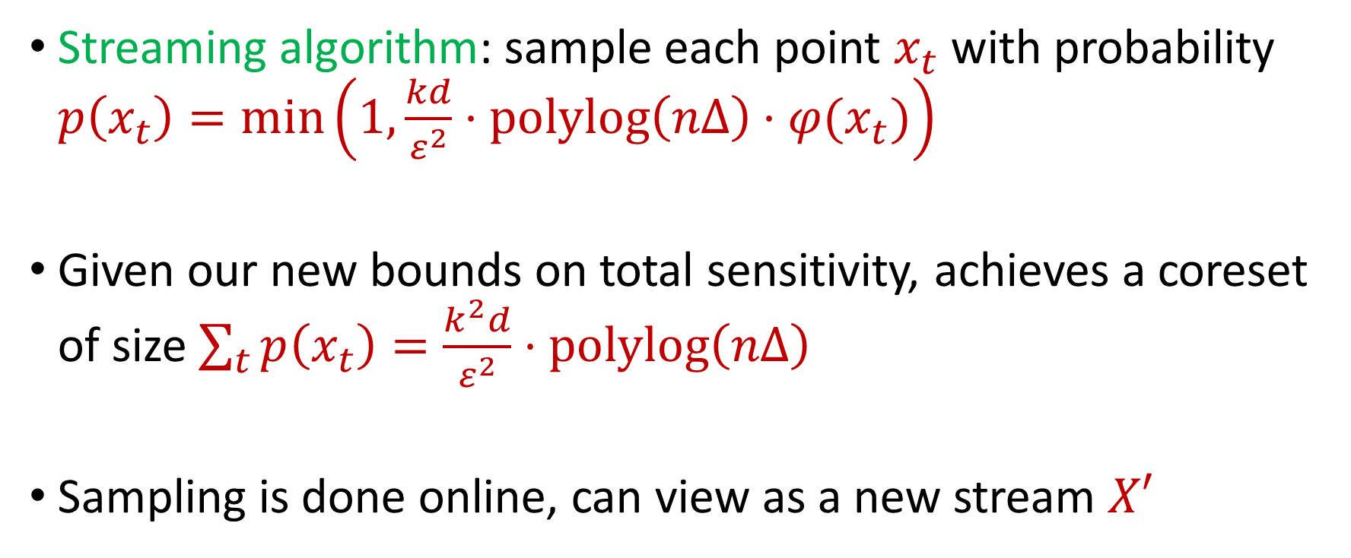
Online Sensitivity
Streaming algorithm: sample each point $x_{t}$ with probability $p\left(x_{t}\right)=\min\left(1,\frac{kd}{ε^{2}}⋅polylog\left(nΔ\right)⋅φ(x_{t})\right)$
Given our new bounds on total sensitivity, achieves a coreset of size $\sum_{t}{p\left(x_{t}\right)}=\frac{k^{2}d}{ε^{2}}⋅polylog\left(nΔ\right)$
Sampling is done online, can view as a new stream $X′$

Slide 48

$$φ\left(x_{t}\right)=\max_{C:\left|C\right|≤k}{\frac{Cost\left(x_{t},C\right)}{Cost\left(X_{t},C\right)}}=\max_{C:\left|C\right|≤k}{\frac{Cost\left(x_{t},C\right)}{\sum_{i=1}^{t}{Cost\left(x_{i},C\right)}}}$$

Slide 49
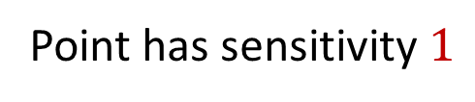
$$φ\left(x_{t}\right)=\max_{C:\left|C\right|≤k}{\frac{Cost\left(x_{t},C\right)}{Cost\left(X_{t},C\right)}}=\max_{C:\left|C\right|≤k}{\frac{Cost\left(x_{t},C\right)}{\sum_{i=1}^{t}{Cost\left(x_{i},C\right)}}}$$
Point has sensitivity $1$

Slide 50
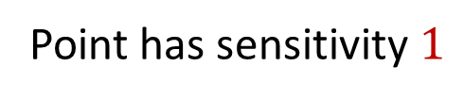
$$φ\left(x_{t}\right)=\max_{C:\left|C\right|≤k}{\frac{Cost\left(x_{t},C\right)}{Cost\left(X_{t},C\right)}}=\max_{C:\left|C\right|≤k}{\frac{Cost\left(x_{t},C\right)}{\sum_{i=1}^{t}{Cost\left(x_{i},C\right)}}}$$
Point has sensitivity $1$
Point has sensitivity $1$

Slide 51
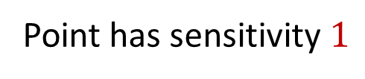
$$φ\left(x_{t}\right)=\max_{C:\left|C\right|≤k}{\frac{Cost\left(x_{t},C\right)}{Cost\left(X_{t},C\right)}}=\max_{C:\left|C\right|≤k}{\frac{Cost\left(x_{t},C\right)}{\sum_{i=1}^{t}{Cost\left(x_{i},C\right)}}}$$
Point has sensitivity $1$
Point has sensitivity $1$
Point has sensitivity $1$

Slide 52

$$φ\left(x_{t}\right)=\max_{C:\left|C\right|≤k}{\frac{Cost\left(x_{t},C\right)}{Cost\left(X_{t},C\right)}}=\max_{C:\left|C\right|≤k}{\frac{Cost\left(x_{t},C\right)}{\sum_{i=1}^{t}{Cost\left(x_{i},C\right)}}}$$
Point has sensitivity $1$
Point has sensitivity $1$
Point has sensitivity $1$
Point has sensitivity $1$

Slide 53

$$φ\left(x_{t}\right)=\max_{C:\left|C\right|≤k}{\frac{Cost\left(x_{t},C\right)}{Cost\left(X_{t},C\right)}}=\max_{C:\left|C\right|≤k}{\frac{Cost\left(x_{t},C\right)}{\sum_{i=1}^{t}{Cost\left(x_{i},C\right)}}}$$
Point has sensitivity $1$
Point has sensitivity $1$
Point has sensitivity $1$
Point has sensitivity $1$
Point has sensitivity $1$

Slide 54

$$φ\left(x_{t}\right)=\max_{C:\left|C\right|≤k}{\frac{Cost\left(x_{t},C\right)}{Cost\left(X_{t},C\right)}}=\max_{C:\left|C\right|≤k}{\frac{Cost\left(x_{t},C\right)}{\sum_{i=1}^{t}{Cost\left(x_{i},C\right)}}}$$
Point has sensitivity $1$
Point has sensitivity $1$
Point has sensitivity $1$
Point has sensitivity $1$
Point has sensitivity $1$
Point has sensitivity $1$

Slide 55

$$φ\left(x_{t}\right)=\max_{C:\left|C\right|≤k}{\frac{Cost\left(x_{t},C\right)}{Cost\left(X_{t},C\right)}}=\max_{C:\left|C\right|≤k}{\frac{Cost\left(x_{t},C\right)}{\sum_{i=1}^{t}{Cost\left(x_{i},C\right)}}}$$
Point has sensitivity $1$
Point has sensitivity $1$
Point has sensitivity $1$
Point has sensitivity $1$
Point has sensitivity $1$
Point has sensitivity $1$
Point has sensitivity $1$

Slide 56

Sum of Online Sensitivity
Sum of online sensitivities can be at least $k$
How large can it be?

Slide 57
$$φ\left(x_{t}\right)=\max_{C:\left|C\right|≤k}{\frac{Cost\left(x_{t},C\right)}{Cost\left(X_{t},C\right)}}=\max_{C:\left|C\right|≤k}{\frac{Cost\left(x_{t},C\right)}{\sum_{i=1}^{t}{Cost\left(x_{i},C\right)}}}$$

Slide 58
$$φ\left(x_{t}\right)=\max_{C:\left|C\right|≤k}{\frac{Cost\left(x_{t},C\right)}{Cost\left(X_{t},C\right)}}=\max_{C:\left|C\right|≤k}{\frac{Cost\left(x_{t},C\right)}{\sum_{i=1}^{t}{Cost\left(x_{i},C\right)}}}$$

Slide 59

Sum of Online Sensitivity
Sum of online sensitivities can be at least $k$
Intuition: The sum of the sensitivities in each cluster induced by $OPT$ is at most $1$
Since there are $k$ clusters, the sum of the online sensitivities is $O_{z}(k\log^{2}{ndΔ})$

Slide 60

Insertion-Only Algorithm
Perform online sensitivity sampling to implicitly create new stream $X′$
In parallel, run merge-and-reduce on $X^{′}$

Slide 61

Insertion-Only Summary
New stream $X′$ has length $\frac{k^{2}d}{ε^{2}}⋅polylog\left(nΔ\right)$
Can run merge-and-reduce framework on $X^{′}$
Recall total space used by merge-and-reduce was $f\left(k,\frac{\log{n}}{ε}\right)⋅O(log{n)}$ points, but $n$ was the length of the stream
Total space is $f\left(k,\frac{\log{|S^{′}|}}{ε}\right)⋅O(log{|X′|)}$ points with $f\left(k,\frac{1}{ε}\right)=\tilde{O}\left(\frac{k}{ε^{2}}\right)⋅\min\left(k,\frac{1}{ε^{z}}\right)$, i.e., $o(\log{n)}$

Slide 62
Questions?
Format
Part 1: Background
Part 2: Insertion-Only Streams
Part 3: $k$-Median on Dynamic Streams
Part 4: $(k,z)$-Clustering on Dynamic Streams

Slide 63

Insertion-Deletion Streams
Use first pass to estimate sensitivity of each point $n$ in the stream
Use second pass to perform sensitivity sampling

Slide 64

Sensitivity Estimation
Sensitivity of a point $x$is $s\left(x\right)≔\max_{C}\frac{Cost\left(x, C\right)}{Cost\left(X, C\right)}$
Suppose $S$is the optimal (capacitated) set of $k$centers, so that $Cost\left(X,S\right)≤Cost(X,C)$ for all sets $C$of $k$ centers

Slide 65



Sensitivity Estimation
$$\frac{Cost\left(x,C\right)}{Cost\left(X,C\right)}≤\frac{2^{z}⋅Cost\left(x,C\right)}{Cost\left(X,S\right)+Cost\left(C,S\right)}$$
$$≤\frac{{2⋅2}^{2z}⋅Cost\left(x,C\right)}{Cost\left(X,S\right)+Cost\left(X,C\right)}$$
$$≤\frac{2^{O(z)}⋅Cost\left(x,C\right)}{Cost\left(X,C\right)}$$

Slide 66

Sensitivity Estimation
Takeaway: Can use a “good” (capacitated) set $S$ of $k$centers along with an approximation of its cost to estimate sensitivities $s\left(x\right)$ of all points
How to find such an estimate?
Cannot use online sensitivity sampling or merge-and-reduce anymore

Slide 67
Quadtree Embedding

Slide 68

Quadtree Embedding
$$Δ$$

Slide 69
Quadtree Embedding
$$Δ$$

Slide 70
Quadtree Embedding
$$Δ$$

Slide 71

Quadtree Embedding
Total cost: $0$
Level cost: $0$
7
$$Δ$$
6
6

Slide 72

Quadtree Embedding
Total cost: $\frac{Δ}{2}⋅7$
Level cost: $\frac{Δ}{2}⋅7$
7
$$Δ$$
6
6

Slide 73

Quadtree Embedding
Total cost: $\left(\frac{7}{2}+\frac{11}{4}\right)Δ$
Level cost: $\frac{Δ}{4}⋅11$
7
$$Δ$$
6
6

Slide 74

Quadtree Embedding
Earth mover distance: $EMD\left(C,X\right)$ denotes the $k$-median clustering cost $Cost\left(C,X\right)$for $X$ a (capacitated) set $C$ of centers
Quadtree embedding: For a (weighted) set $C$ of centers, the quadtree embedding outputs $Z$ such that
$$EMD\left(C,X\right)≤O\left(\sqrt{d}\right)⋅Z≤⋅O\left(d^{1.5}\right)(\log{k+\log{\log{Δ)}}}EMD(C,X)$$

Slide 75

Quadtree Embedding
Quadtree embedding produces a vector of dimension $Δ^{O(d)}$
The computation of $Z$ is the sum of the level costs, which is the $L_{1}$ norm of the frequency vector
There exists a one-pass streaming algorithm that outputs a constant-factor approximation to the $L_{1}$ norm of a frequency vector in $ℝ^{n}$ and uses $O\left(\log{n}\right)$ bits of space [Indyk06]

Slide 76


$L_{1}$ Norm Approximation
There exists a one-pass streaming algorithm that outputs a constant-factor approximation to the $L_{1}$ norm of an underlying vector $x$ in $ℝ^{n}$ and uses $O\left(\log{n}\right)$ bits of space [Indyk06]
Generate vector $v_{1},…v_{α}∈ℝ^{n}$ of Cauchy random variables (ratio of two normal random variables) for $α=O(1)$
Output ${median}_{i∈\left[α\right]}\left\{\left|\left\langle v_{1},x\right\rangle \right|,…, \left|\left\langle v_{α},x\right\rangle \right|\right\}$

Slide 77

EMD Sketch
EMD sketch: There exists a one-pass streaming algorithm that uses $O\left(d\log{Δ}\right)$ bits of space and outputs $Z$ such that
$$EMD\left(C,X\right)≤O\left(\sqrt{d}\right)⋅Z≤⋅O\left(d^{1.5}\right)(\log{k+\log{\log{Δ)}}}EMD(C,X)$$

Slide 78

EMD Sketch
[BackursIndykRazenshteynWoodruff16] To estimate $\min_{C, \left|C\right|≤k} Cost(C,X)$, it suffices to union bound over a net of size $exp\left(kd\left(\log{\log{Δ}}\right)\right)$
EMD sketch: There exists a one-pass streaming algorithm that uses $O\left(kd^{2}\log{Δ}\left(\log{\log{Δ}}\right)\right)$ bits of space and outputs $Z$ (as well as the capacitated set of centers) such that
$$OPT≤O\left(\sqrt{d}\right)⋅Z≤⋅O\left(d^{1.5}\right)(\log{k+\log{\log{Δ)}}}OPT$$

Slide 79

EMD Sketch Summary
EMD sketch: There exists a one-pass streaming algorithm that uses $O\left(kd^{2}\log{Δ}\left(\log{\log{Δ}}\right)\right)$ bits of space and outputs $Z$ (as well as the capacitated set of centers) such that
Recall: Can use a “good” (capacitated) set $S$ of $k$centers along with an approximation of its cost to estimate sensitivities $s\left(x\right)$ of all points
$$OPT≤O\left(\sqrt{d}\right)⋅Z≤⋅O\left(d^{1.5}\right)(\log{k+\log{\log{Δ)}}}OPT$$

Slide 80

First Pass to Second Pass
We can set up the EMD sketch in the first pass of the stream
At the end of the first pass of the stream, we have a data structure that can estimate the sensitivity $s\left(x\right)$ for any query $x∈{\left[Δ\right]}^{d}$
In the second pass of the stream, we would like to perform sensitivity sampling

Slide 81

Sensitivity Sampling
DO NOT: Sample each point $x$ in the stream with probability proportional to $s\left(x\right)$
Does not work for insertion-deletion streams
DO: Sample each point $x$ in the universe ${\left[Δ\right]}^{d}$ into a substream $U′$ with probability proportional to $s(x)$
$U′$can have a large number of points
$U′$can have a small number of points at the end of the stream

Slide 82

Sensitivity Sampling
Sample each point $x$ in the universe ${\left[Δ\right]}^{d}$ into a substream $U′$ with probability proportional to $s(x)$
$U′$will have $poly\left(k,d,\frac{1}{ε^{2}}\right)$ points at the end of the stream
Use sparse recovery on $U′$

Slide 83

Sparse Recovery
Given a stream$U′$ that induces a frequency vector of length $n$ with $s$ nonzero entries, there exists an algorithm that uses $O\left(s\log{n}\right)$ bits of space and recovers the nonzero coordinates and their frequencies
Since elements are sampled into $U′$ by their sensitivities, recovering $U′$by sparse recovery corresponds to sensitivity sampling!

Slide 84


$k$-Median Framework
First pass: set up the EMD sketch
Second pass:
Sample elements into a substream $U′$ with probability proportional to their sensitivities
Run sparse recovery on $U′$

Slide 85
Questions?
Format
Part 1: Background
Part 2: Insertion-Only Streams
Part 3: $k$-Median on Dynamic Streams
Part 4: $(k,z)$-Clustering on Dynamic Streams

Slide 86
$k$-Median Framework
First pass: set up the EMD sketch
Second pass:
Sample elements into a substream $U′$ with probability proportional to their sensitivities
Run sparse recovery on $U′$

Slide 87

Quadtree Embedding
Level cost: $\frac{Δ}{4}⋅11$
7
$$Δ$$
6
6

Slide 88

Quadtree Embedding
Level cost: $\frac{Δ^{2}}{16}⋅11$
7
$$Δ$$
6
6

Slide 89

Quadtree Embedding
If $x$ and $c$ have distance $αΔ$, the probability it will be split by a grid of length $\frac{Δ}{2^{i}}$ is roughly $\frac{2^{i}}{α}$
Expected cost for $k$-median is $αΔ$
Expected cost of $k$-means is $\frac{Δ^{2}}{2^{i}α}$, i.e., distortion $2^{i}α^{3}$
Recall: worse EMD sketch guarantee corresponds to larger oversampling necessary for sensitivity sampling

Slide 90
Quadtree Embedding
Intuition: Bad distortion results when pairs of points are “too close” to the boundary of the hypergrid
Goal: Prevent this case from happening
Fix: When a query center is too close to the boundary of the hypergrid, create another center on the opposite cell!

Slide 91
Quadtree Embedding
7
$$Δ$$
6
6

Slide 92
Quadtree Embedding
7
$$Δ$$
6
6

Slide 93
Quadtree Embedding
7
$$Δ$$
6
6

Slide 94
Quadtree Embedding
7
$$Δ$$
6
6

Slide 95
Quadtree Embedding
7
$$Δ$$
6
6

Slide 96

Quadtree Embedding
Make a new center when distance from query center and hypergrid with length $2^{i}$ is at most $\frac{2^{i}}{d\log{Δ}}$
In expectation (over $d$ dimensions, $\log{Δ}$ levels of the hypergrid, and $k$ query centers), $O(k)$ new centers are created

Slide 97

Wasserstein Sketch
Wasserstein-$z$ distance: $WASSD\left(C,X\right)$ denotes the $(k,z)$-clustering cost $Cost\left(C,X\right)$for $X$ a (capacitated) set $C$ of centers
Wasserstein sketch: There exists a one-pass streaming algorithm that uses $O\left(d\log{Δ}\right)$ bits of space and outputs $Z$ such that
$$Z≤⋅O\left(d^{1+0.5z}\log^{z−1}{Δ}\right)⋅WASSD(C,X)$$

Slide 98


Applying $k$-Median Framework to $k$-Means
First pass: set up the Wasserstein sketch
Second pass:
Sample elements into a substream $U′$ with probability proportional to their sensitivities
Run sparse recovery on $U′$

Slide 99

Applying $k$-Median Framework to $k$-Means
Problem: Because the distortion of the Wasserstein embedding is $O\left(d^{1+0.5z}\log^{z−1}{Δ}\right)$, we need to sample $O\left(d^{2}\log{Δ}\right)$ points for $k$-means
For $k$-median, we stored all the points, using $O\left(d\log{Δ}\right)$ bits of space per point
Cannot afford to store all points explicitly here

Slide 100

Applying $k$-Median Framework to $k$-Means
Cannot afford to store all points explicitly here
Instead, store offset of each point from one of the centers of near-optimal solution $S$
For each point $x$, let $c_{x}$ be the closest center of $S$ and $y=c_{x}−x$
Round $y$ coordinate-wise to nearest power of $1+poly\left(\frac{ε}{log ndΔ}\right)$ and store the vector of exponents $\tilde{y}$

Slide 101


Quadtree Embedding
$$x$$
$$c_{x}$$
$$Δ$$

Slide 102

Quadtree Embedding
$$x$$
$$y=c_{x}−x$$
$$c_{x}$$
$$Δ$$

Slide 103

Quadtree Embedding
$$x$$
$$\tilde{y}$$
$$c_{x}$$
$$Δ$$

Slide 104


$k$-Means Framework
First pass: set up the Wasserstein-$z$ sketch
Second pass:
Sample offsets of elements into a substream $U′$ with probability proportional to their sensitivities
Run sparse recovery on $U′$

Slide 105


$k$-Means Framework
We show the resulting samples forms a semi-coreset
Sample $O\left(d^{2}\log{Δ}\right)$ points, each point using $d⋅O\left(\log{\frac{1}{ε}+\log{\log{ndΔ}}}\right)$
Total space: $\tilde{O}\left(\frac{1}{ε^{2}}\right)⋅poly\left(d,k,\log{\log{nΔ}}\right)$ words

Slide 106

Summary
Insertion-only for $(k,z)$-clustering: One-pass streaming algorithm that uses $\tilde{O}\left(\frac{dk}{ε^{2}}\right)⋅\min\left(k,\frac{1}{ε^{z}}\right)⋅poly(\log{\log{nΔ)}}$ words of space
Insertion-deletion for $k$-median and $k$-means: Two-pass streaming algorithms that use $\tilde{O}\left(\frac{1}{ε^{2}}\right)⋅poly\left(d,k,\log{\log{nΔ}}\right)$ words of space
Lower bounds: Even $2$-approximation to the $(k,z)$-clustering cost from a weighted subset of the input uses $Ω\left(\log^{2}{n}\right)$ bits of space on insertion-deletion streams in one pass

Slide 107


Bounding Sum of Online Sensitivity
Let $X=\left\{x_{1},…,x_{n}\right\}⊂{\left[Δ\right]}^{d}$ and let $t_{i−1}$ and $t_{i}$ be times between which the optimal cost of the stream doubles
Let $K_{i}$ be the optimal clustering at time $t_{i}$ and $π:X_{t_{i}}→K_{i}$ be the mapping
By triangle inequality,
$$\frac{Cost\left(x_{t},C\right)}{Cost\left(X_{t},C\right)}≤\frac{2^{z−1}⋅Cost\left(x_{t},π\left(x_{t}\right)\right)}{Cost\left(X_{t},C\right)}+\frac{2^{z−1}⋅Cost\left(π(x_{t}),C\right)}{Cost\left(X_{t},C\right)}$$

Slide 108



Bounding Sum of Online Sensitivity
$$φ\left(x_{t}\right)=\frac{Cost\left(x_{t},C\right)}{Cost\left(X_{t},C\right)}≤\frac{2^{z−1}⋅Cost\left(x_{t},π\left(x_{t}\right)\right)}{Cost\left(X_{t},C\right)}+\frac{2^{z−1}⋅Cost\left(π(x_{t}),C\right)}{Cost\left(X_{t},C\right)}$$
For $t∈\left(t_{i−1},t_{i}\right]$, we have $Cost\left(X_{t},C\right)>\frac{1}{2}⋅{OPT}_{i}$
By triangle inequality, $\frac{Cost\left(π\left(x_{t}\right), C\right)}{Cost\left(X_{t}, C\right)}≤3⋅\frac{2^{z−1}}{\left|S_{t}\right|}$, where $S_{t}$ is the subset of $X_{t}$ that maps to $π\left(x_{t}\right)$
$$\sum_{t∈\left(t_{i−1},t_{i}\right]}{φ\left(x_{t}\right)}≤\sum_{t∈\left(t_{i−1},t_{i}\right]}{\left(2^{z−1}+3⋅\frac{2^{2z−2}}{\left|S_{t}\right|}\right)}$$

Slide 109


Bounding Sum of Online Sensitivity
$$\sum_{t∈\left(t_{i−1},t_{i}\right]}{φ\left(x_{t}\right)}≤\sum_{t∈\left(t_{i−1},t_{i}\right]}{\left(2^{z−1}+3⋅\frac{2^{2z−2}}{\left|S_{t}\right|}\right)}$$
Since $S_{t}$ is the subset of $X_{t}$ that maps to $π\left(x_{t}\right)$ and can be one of $k$ subsets, then $\sum_{t}{S_{t}}≤k\left(1+…+\frac{1}{n}\right)≤k\log{n}$
Taking the sum over $O(\log{ndΔ})$ possible indices $i$, the sum of the online sensitivities is $O(2^{2z}k\log^{2}{ndΔ})$

